Slide 1
NON-CONTACT INFRARED TEMPERATURE SENSOR
SUBMITTED BY
APARNA R
FEMINA PA
SANDHYA PRADEEP
VARSHA MC

Slide 2
RELEVANCE
A Non Contact Infrared Temperature Sensor helps to check the body temperature without even touching the body which is very important in this current pandemic situation.

Slide 3
A DIY non contact IR temperature sensor have been Around on internet for ages but they don’t take into Consideration the distance inacccuracy & limitations Of “MLX90614 IR Temperature sensor”.
We’ve solved this problem by using a Proximity Sensor that only allows temperature measurement from a fixed/pre-defined distance.

Slide 4
COMPONENTS REQUIRED
MLX90614 IR temperature sensor
APDS-9960 proximity sensor
128*32 12C OLED display
Arduino Nano
Piezo Buzzer
TP4056 Battery charging Module
18650 Li-ion rechargeable Cell
Push button switch

Slide 5
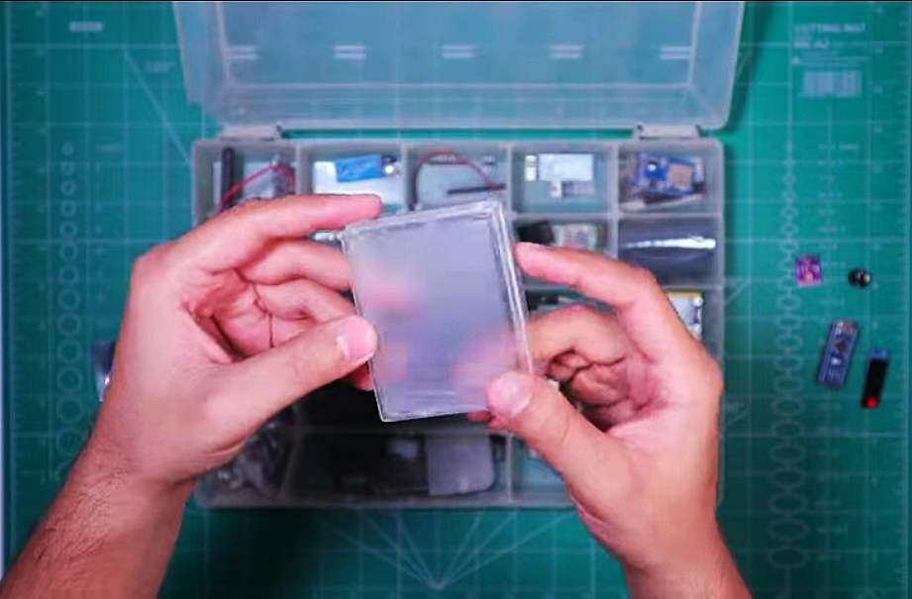
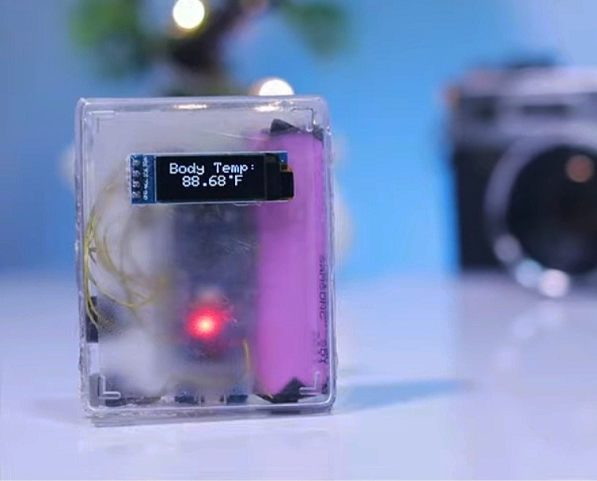
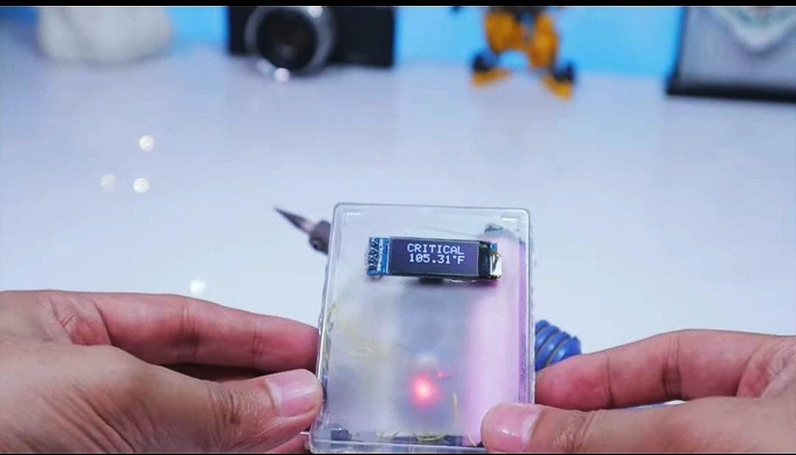
DESIGN
Non contact temperature sensor used in medical field has a 3D printed outer case ,which is expensive .So here we make use of a PLASTIC CASE to set up the whole circuit.

Slide 6
BLOCK DIAGRAM
PIEZO BUZZER
ARDUINO NANO
SWITCH
Li-ion RECHARGEABLE CELL
OLED DISPLAY
MLX90614 SENSOR
PROXIMITY SENSOR

Slide 7
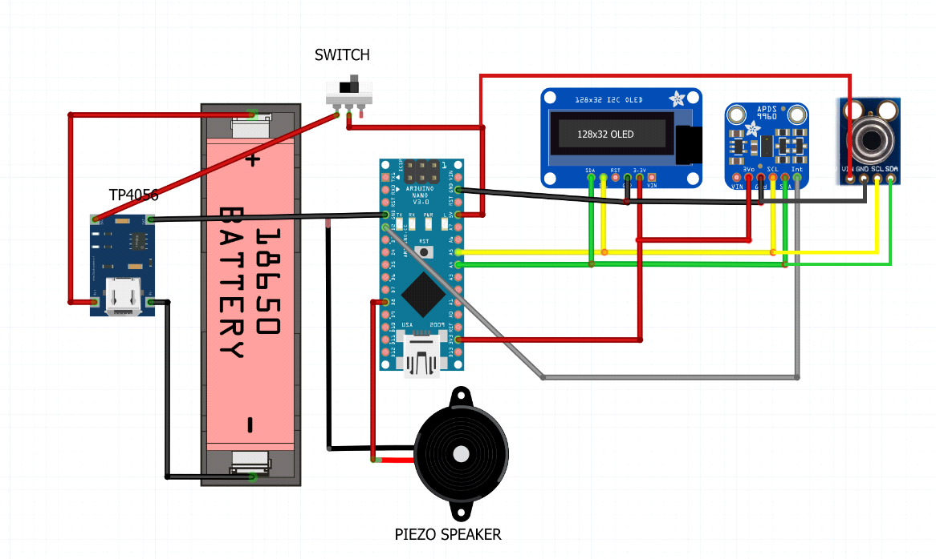
CIRCUIT DIAGRAM

Slide 8
START
CONFIGURE THE INPUT
OTPUT PINS OF ARDUINO
READ THE PROXIMITY SENSOR
FLOW CHART
READ THE IR SENSOR
IF
TEMPERATURE > 99 DEG C
YES
DISPLAY ON OLED
RING THE
BUZZER

